Slide 1
LITERATURE SURVEY
TEAM NO :07
Feature Selection Using Genetic Algorithm Sentiment Analysis
Kiran Kumar – 20BCS056
Ajay Sundar Rajkumar– 20BCS006
Hari Gokul – 20BCS033
Bharath S – 20BCS021
Faculty Name
V.SENTHIL KUMAR AP II/CSE
Kumaraguru College of Technology/
Coimbatore
Engineering Clinic V
Sem V |CSE | Kumaraguru College of Technology

Slide 2
Presentation Outline
TEAM NO :04
Literature Survey
Inference
Problem Statement
Dataset Used
Block diagram for Proposed System
Front End & Back End
Timeline using Gantt chart
References
Kumaraguru College of Technology/
Coimbatore
Engineering Clinic V
Sem V |CSE | Kumaraguru College of Technology

Slide 3
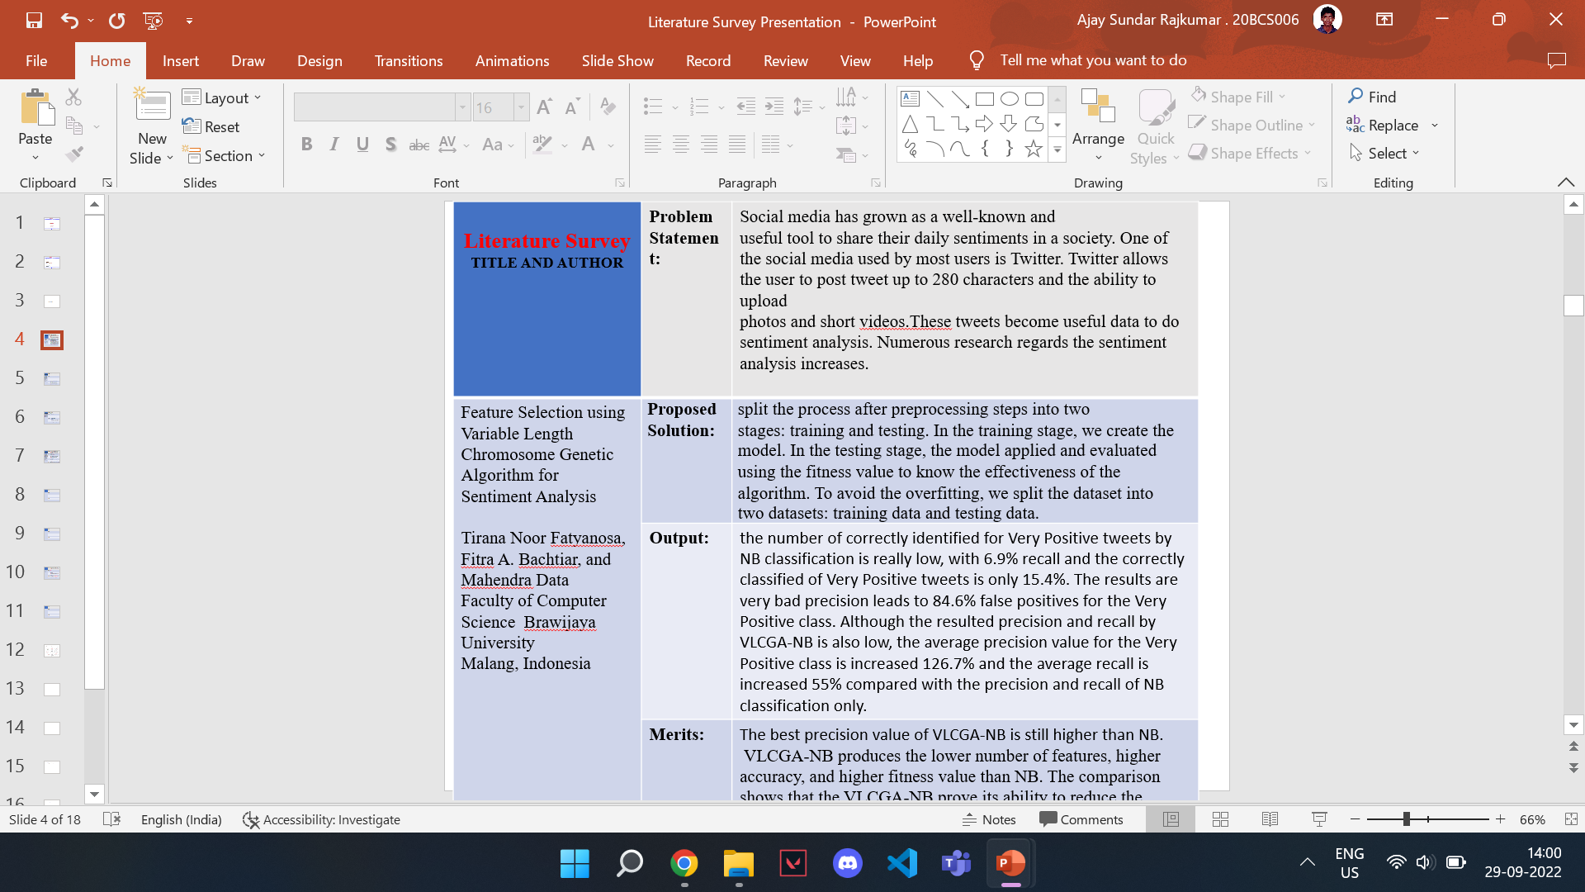
(2019)

Slide 4
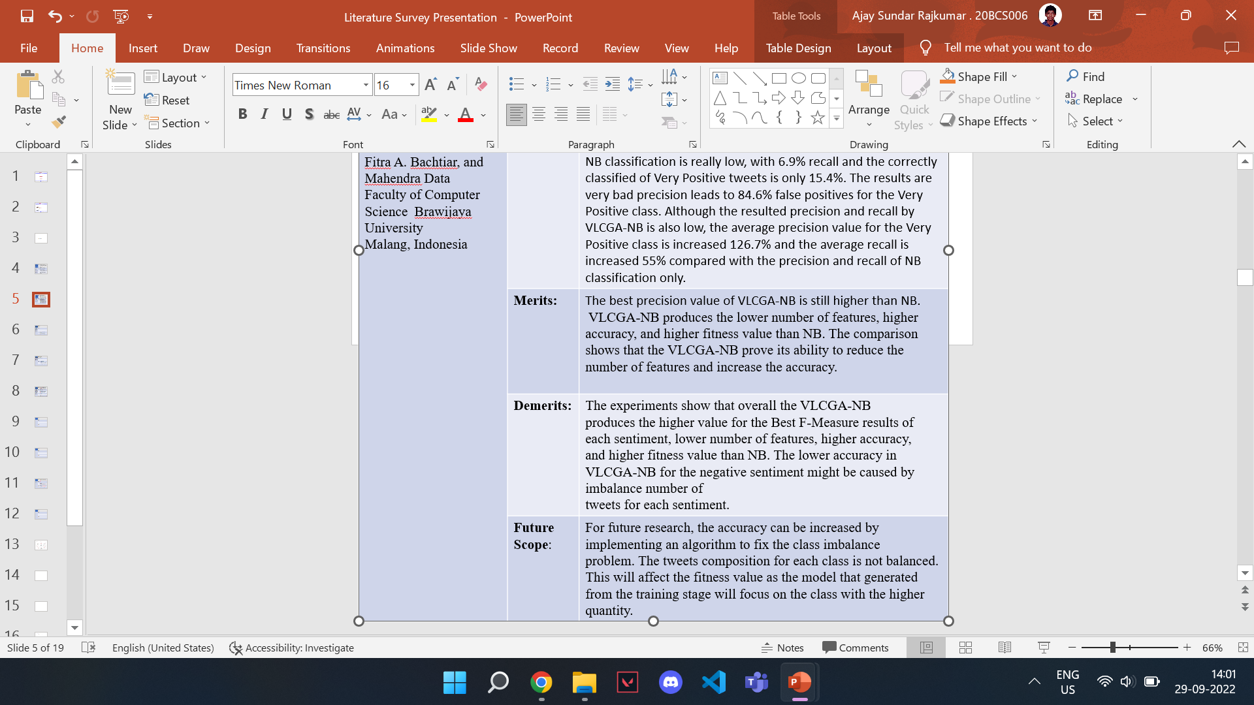

Slide 5
Literature Survey TITLE AND AUTHOR | Problem Statement: | A Hybrid Framework for Sentiment Analysis Using Genetic Algorithm Based Feature Reduction. Dataset: UCI ML Repository’s Sentiment Analysis (IMDB, Amazon, and Yelp), Twitter dataset, geopolitical dataset(US Presidential Election).
A Hybrid Framework for Sentiment Analysis Using Genetic Algorithm Based Feature Reduction FARKHUND IQBAL 1 , JAHANZEB MAQBOOL HASHMI2 , BENJAMIN C. M. FUNG 3 , (Senior Member, IEEE), RABIA BATOOL1 , ASAD MASOOD KHATTAK1 , SAIQA ALEEM 1 , AND PATRICK C. K. HUNG 4 date of publication January 21, 2019 | Proposed Solution: | A unified framework has been developed which includes all the components required in sentiment analysis. This modular method provides different approaches to sentiment analysis with a focus on optimizations.
 | Output: | The novel approach resulted in 36% - 42% reduced feature size and about 5% increased efficiency as compared to a normal ML approach. This sentiment analysis framework has proved to be a great addition in the discipline of opinion mining.
 | Merits: | Flexibility of choosing among three widely used sentiment analysis techniques. Reduces feature size and improves efficiency while maintaining the scalability. Great addition in the discipline of opinion mining.
 | Demerits: | Execution time spent in GA operations can be reduced by employing different parallelization techniques.
 | Future Scope: | In the future, extension of framework for cyber-intelligence will be done so that it would help generate recommendations for law-enforcement agencies based on user opinions.

Slide 6
Literature Survey TITLE AND AUTHOR | Problem Statement: | Effective analysis of The dataset was taken from a Kaggle facial expression recognition challenge.
Sentiment Analysis on Social Media Using Genetic Algorithm with CNN Dharmendra Dangi* , Amit Bhagat and Dheeraj Kumar Dixit (2020) | Proposed Solution: | Dataset Pre-Processing. Genetic Algorithm Approach.
 | Output: | The proposed approach was examined using a Kaggle face sentiment dataset. A comparison with the top-performing approaches in the field revealed that this approach achieves up to 96.984% accuracy.
 | Merits: | Proposed approach is automatic. Easy to use, even for users without comprehensive knowledge of CNNs or GAs.
 | Demerits: | The GA-based hyperparameter search is quite a slow process. Improper initialization of first-generation individuals could lead to inefficient individuals. The minimum and maximum limits for the parameter space play a vital role in convergence speed.
 | Future Scope: | GA was applied only to filter sizes and filter counts for three blocks. Can be performed on more hyperparameters in the future. Better algorithms can be employed for the crossover and mutation of new individuals.

Slide 7
Inference From literature Survey
Smaller feature size improves efficiency while maintaining the scalability.
ML and genetic algorithm will increase accuracy of sentiment analysis from the dataset
Flexibility of choosing among three widely used sentiment analysis techniques.
Observation List

Slide 8
PROBLEM STATMENT
Our goal is to do sentiment analysis of social media comments and other datasets using genetic algorithm (GA).
Sentiment analysis becomes one of the topics that attract the researchers with various issues, such as, political, image sentiment, natural disaster sentiment, and rating review prediction. However, there are several challenges behind the research related to this topic. Such as the preprocessing steps and hardly classified the tweets.

Slide 9
Datasets
Comments from YouTube.
Tweets from Twitter.
Movie reviews from IMDb.
Customer reviews from Amazon.

Slide 10
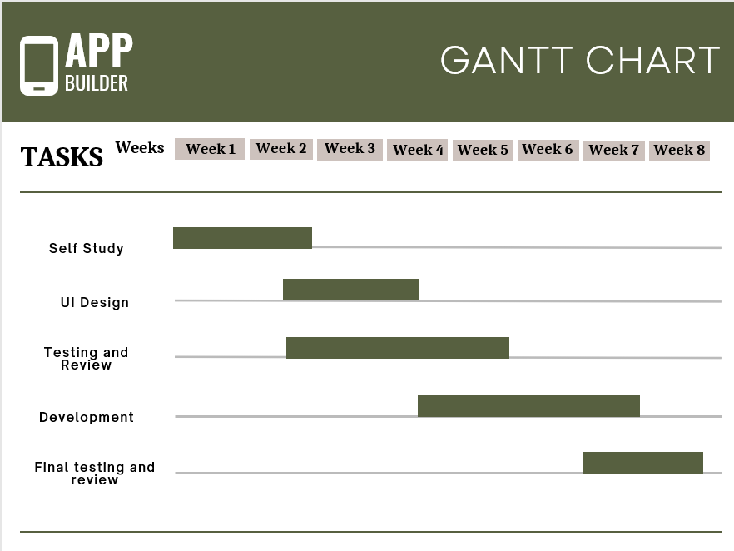

Slide 11


System Requirements
Front End: Python Jupyter
Back End: MongoDB

Slide 12

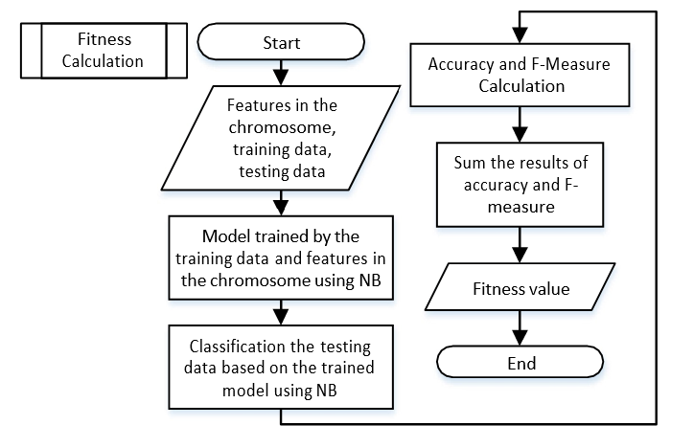


















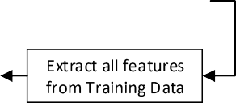



Block diagram of Proposed System
VLCGA Flowchart
Fitness Calculation Flowchart
Sentiment analysis steps

Slide 13
References
https://ieeexplore.ieee.org/stamp/stamp.jsp?tp=&arnumber=8620527
https://ieeexplore.ieee.org/document/8693190
https://monkeylearn.com/sentiment-analysis-online/
https://www.researchgate.net/publication/330527983_A_Hybrid_Framework_for_Sentiment_Analysis_Using_Genetic_Algorithm_Based_Feature_Reduction

Slide 14


